Slide 1
ARETE ENGINEERING PVT.LTD.
W-82,S Block,
MIDC, Bhosari , Pune-411026.
Mob:- +91 9657732828
E-mail : aditya@areteengineering.in
areteengineering82@gmail.com
Website: www.areteengineering.in

Slide 2
COMPANY PROFILE
The company was established in 2010.
ISO 9001-2015 certified by TUV Austria.
Engaged in the Developing & Machining of Precision Automotive & Other Components for various private sector industries .
Having built up area of 5200sq. ft for VMC machine shop with 4th Axis Rotary VMC Machinery & higher precision ratio which excludes the need for HMC’s.
Having a sanctioned electrical capacity of 200HP with individual transformer.
Manufacturing precision components and intricate assemblies for various private/MNCs in and around Pune. The objective was and is to upgrade the business in order to provide better & best solutions to the customers.

Slide 3
Vision & Mission
“To be a preferred supplier of Machined Automotive Components by 2030”
Through :
Maintaining high standards of quality and systems inline with Customer expectations.
Upgrading manufacturing set-up to meet technological challenges and improved efficiencies.
Meeting Quality, Cost and Delivery performances consistently.
Developing technical and managerial skills of work force through trainings.
Maintaining Business ethics , transparency and good communication with Customers.

Slide 4
Quality Policy & Objective
The organization has established, documented, implemented and maintains Quality Management System & continually improves its effectiveness in accordance with the requirements of this QMS as per ISO 9001:2015 international standard.
DIRECTOR ensures that Quality Objectives are relevant to Quality Policy of the organization. These Quality Objectives are established because these are needed to meet the product requirement also. These Quality Objectives are established at related functions & levels within the company.
Quality objectives shall be reviewed as & when required based on business requirements & growth of the organization.

Slide 5
Organization Chart
MANAGING DIRECTOR
Quality In-Charge
Accounts In-Charge
Machine Operators
Quality Inspectors
PRODUCTION MANAGER
Production Supervisors

Slide 6
Manufacturing Set-Up (Vertical Machining Centers)
Sl.No | Machine Make | Capacity
1 | BFW-TC-24 | X/Y/Z Traverse : 800X550X800mm , Control : Fanuc
2 | BFW-TC-24 | X/Y/Z Traverse : 800X550X800mm , Control : Fanuc
3 | JYOTI | X/Y/Z Traverse : 800X550X800mm , Control :Siemens
4 | JYOTI | X/Y/Z Traverse : 800X550X800mm , Control :Siemens
5 | JYOTI | X/Y/Z Traverse : 800X550X800mm , Control :Siemens
6 | JYOTI | X/Y/Z Traverse : 800X550X800mm , Control :Siemens
7 | AMS | X/Y/Z Traverse : 800X550X800mm , Control : Fanuc
8 | AMS | X/Y/Z Traverse : 800X550X800mm , Control : Fanuc
9 | CMM | X/Y/Z Traverse : 800X1000X600mm (ACCURATE SPECTRA)
10 | CMM | ZEISS –{ OUTSOURCED FROM SAMRUDDHI ENGINEERING }

Slide 7
4th Axis Details
SL.NO | Machine Make | All Characteristics | Measurements
01 | NIKKEN | Turn Table Diameter | 260 mm
02 |  | Table Centre Height | 300 mm
03 |  | Servo Motor Torque | 6 Nm
04 |  | Load Capacity | 350 Kgs
05 |  | Driving Torque | 400 Nm
06 |  | Indexing Accuracy | ±15” Arc Sec
07 |  | Repeatability | 4” Arc Sec
08 |  | Center Height | 300 mm

Slide 8
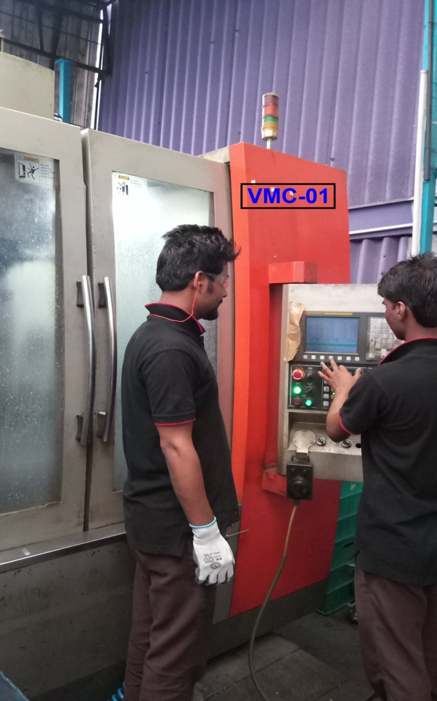
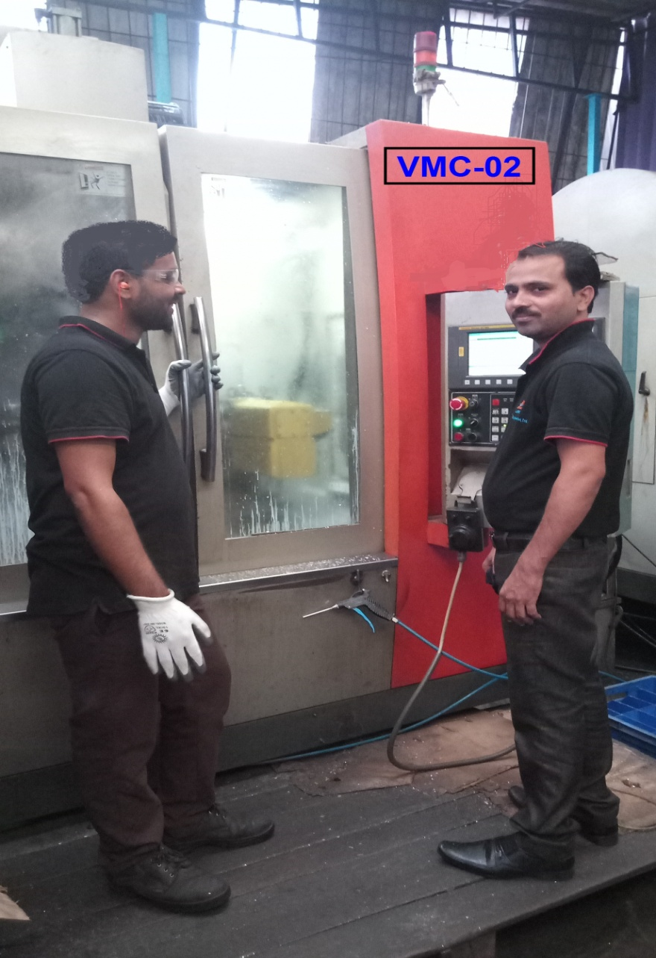
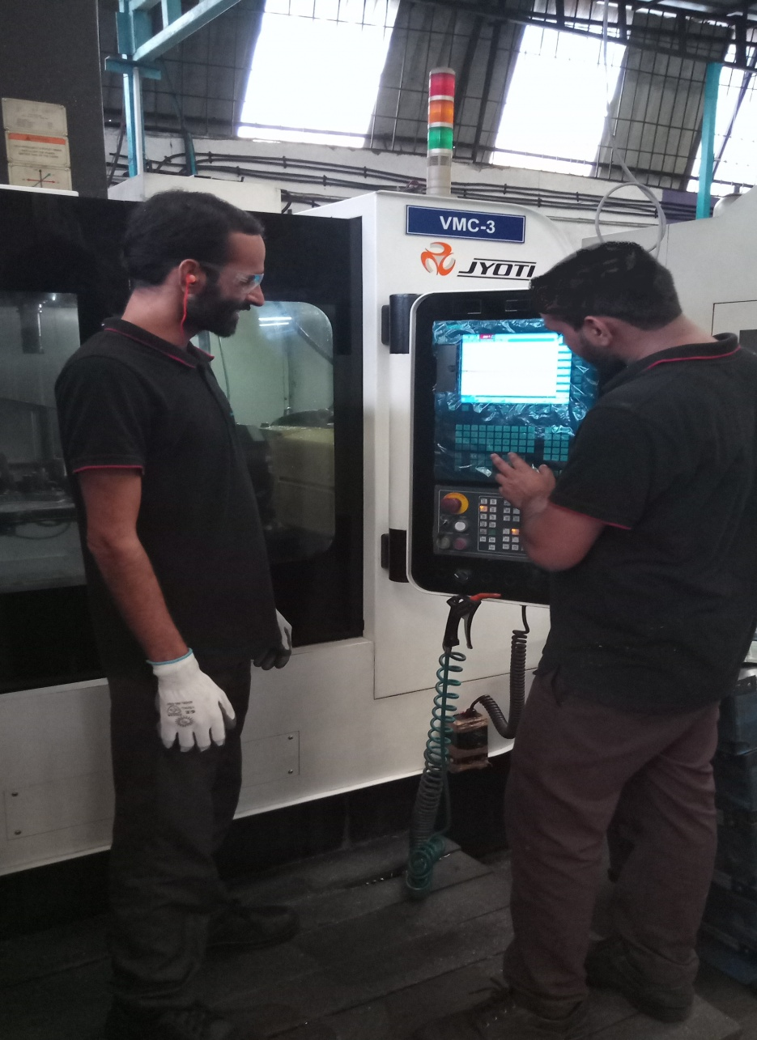
Vertical Machining Centers

Slide 9
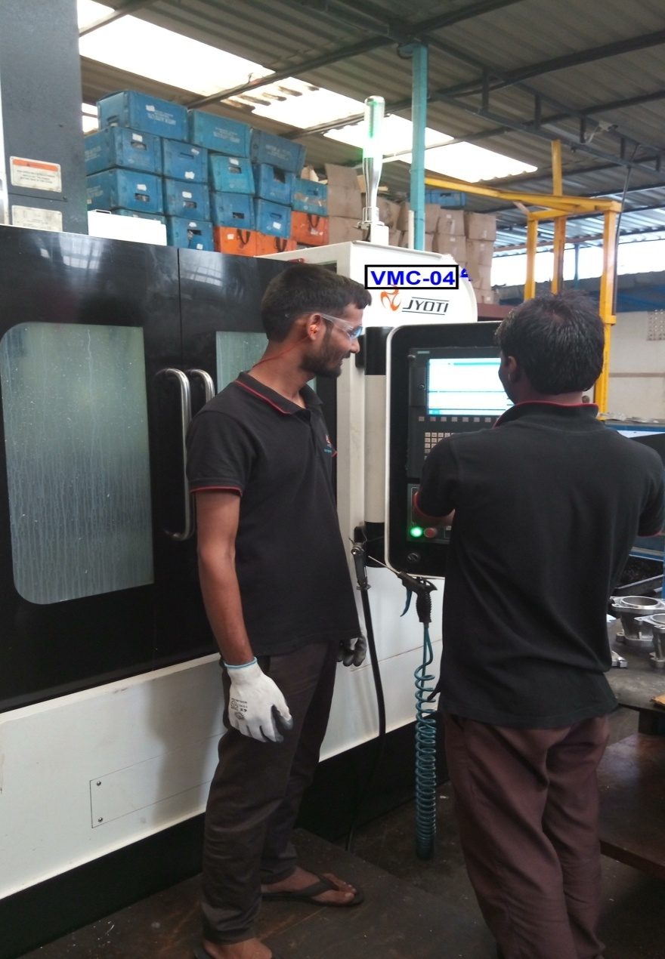
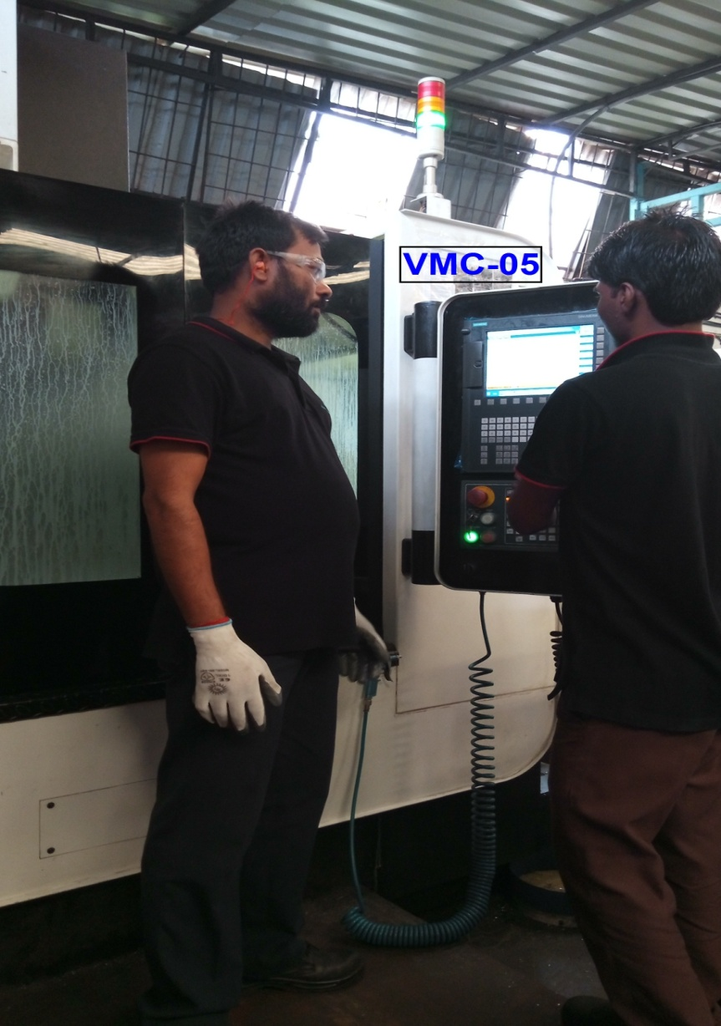
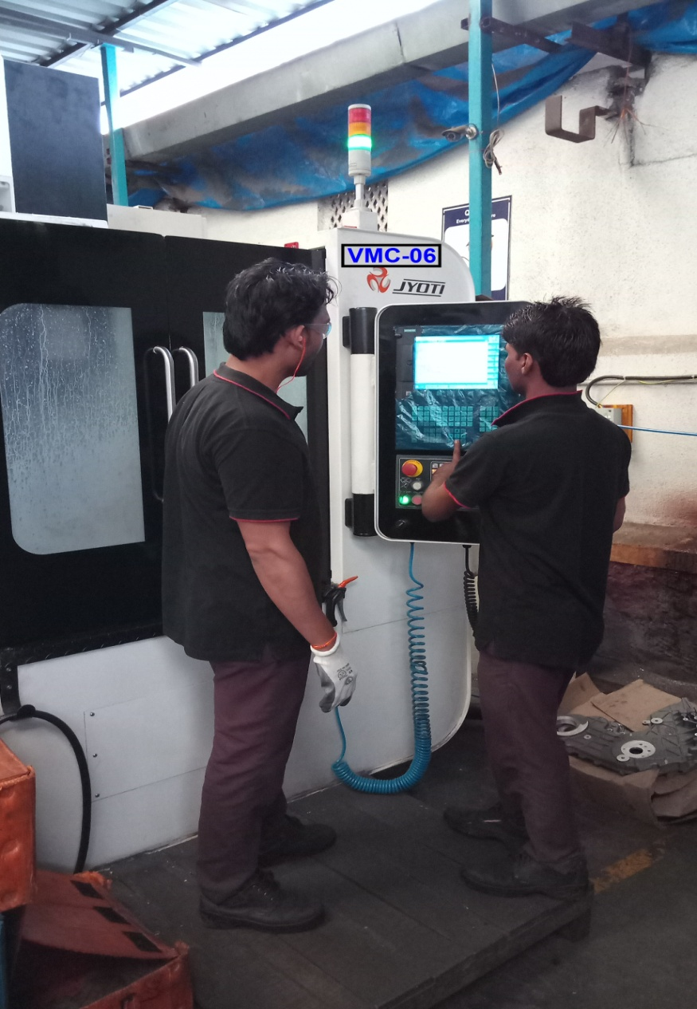
Vertical Machining Centers

Slide 10
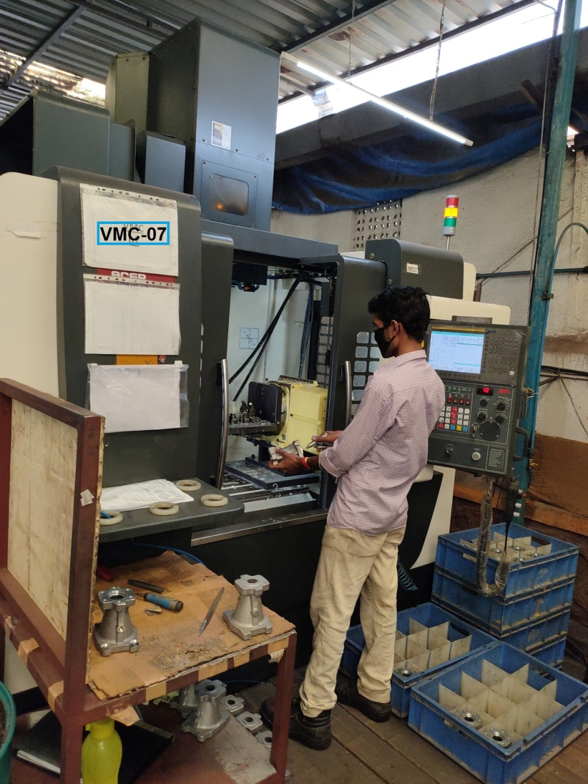
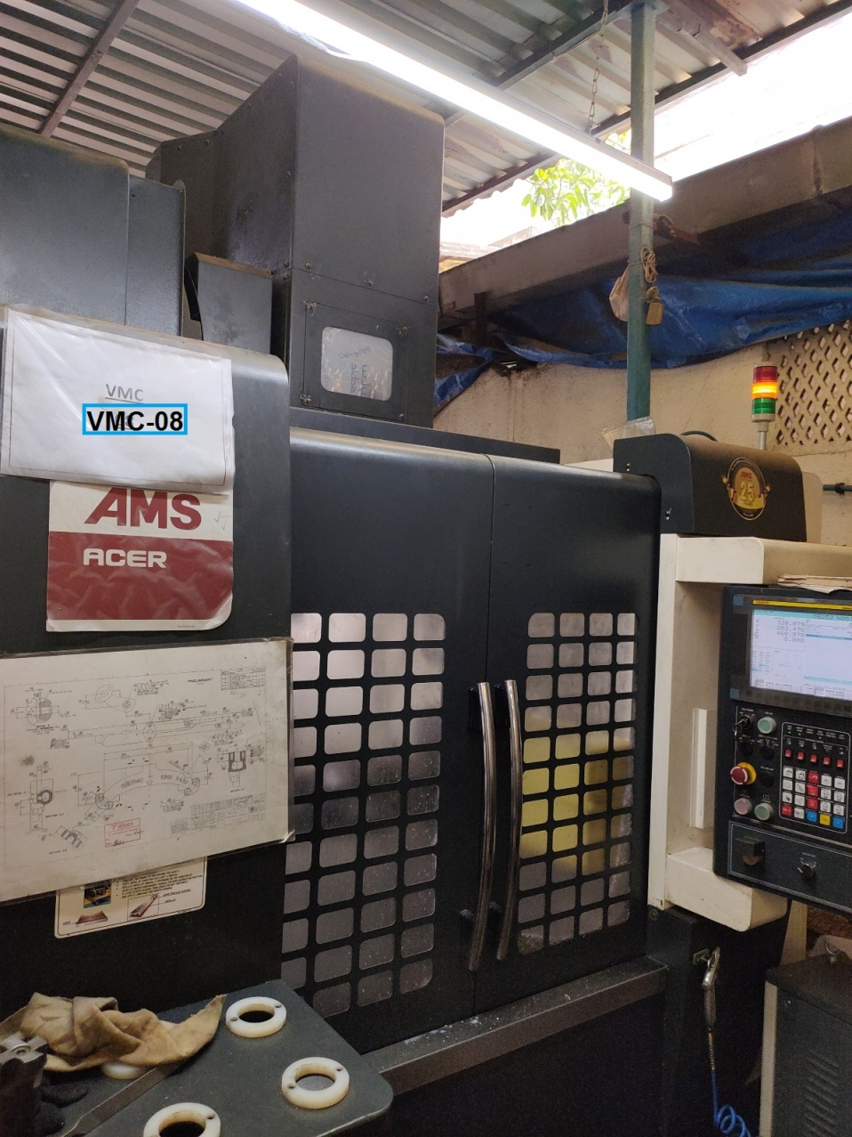

Slide 11
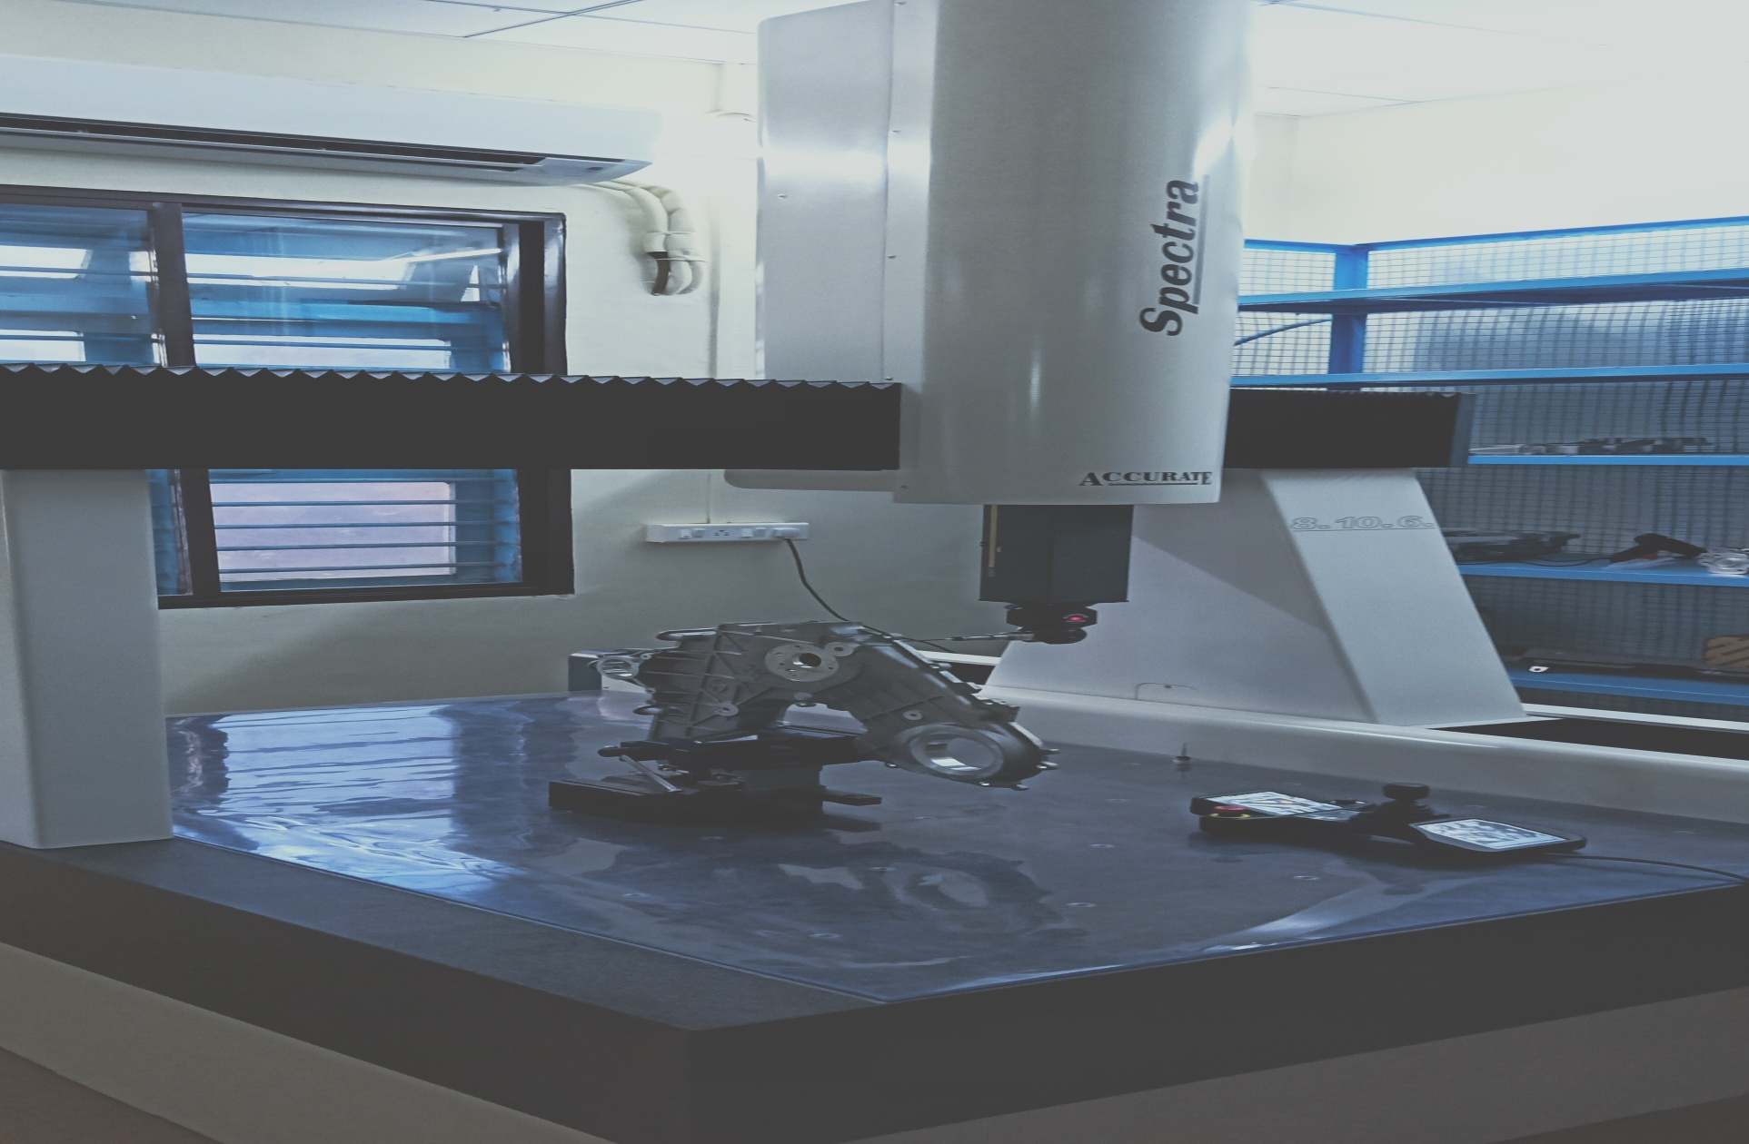
CMM

Slide 12
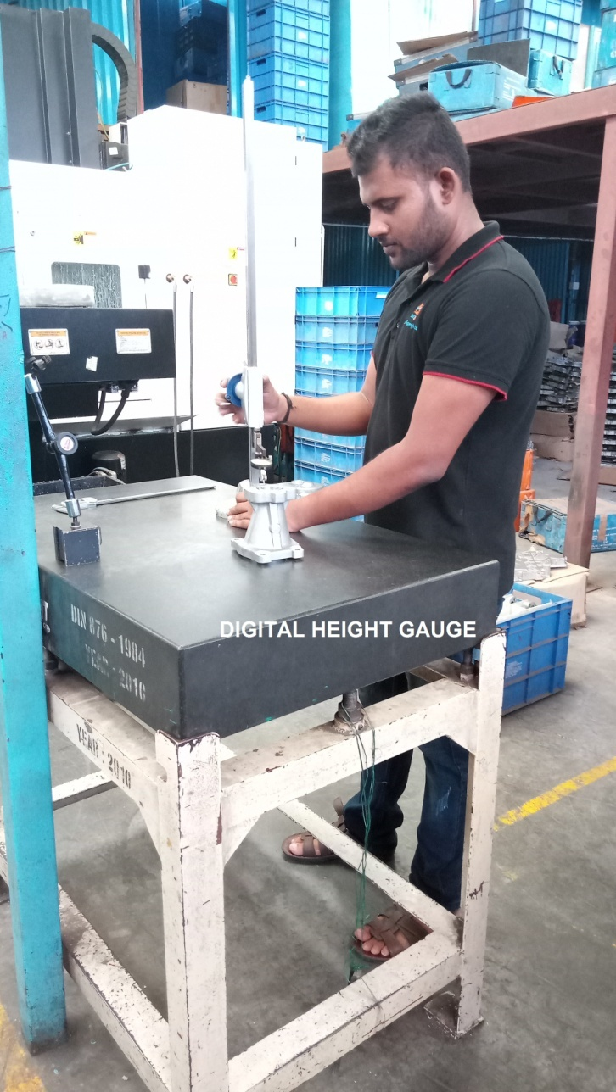
Quality -Instruments
# | Machine Make | Make | Capacity
01 | Digital Height Gauge | Mitutoyo | 0-600mm
02 | Digital Vernier | Mitutoyo | 0-300mm
04 | Lever Dial Gauge | Mitutoyo | 0.01mm
05 | Lever Dial Gauge | Mitutoyo | 0.001mm
06 | Bore Dial Gauge | Mitutoyo | 35-50mm
07 | Bore Dial Gauge | Mitutoyo | 50-150mm
08 | Micrometer | Mitutoyo | 0-25 mm
09 | Micrometer | Mitutoyo | 50-75mm
10 | Micrometer | Mitutoyo | 75-100mm
11 | Feeler Gauge | Mitutoyo | 0.05-1.00mm
12 | Plunger Dial Gauge | Mitutoyo | 0.001mm
13 | Plunger Dial Gauge | Mitutoyo | 0.01mm
14 | Surface Plate | GMT | 1000x630mm
15 | CMM | ACCURATE | 800x1000x600mm

Slide 13
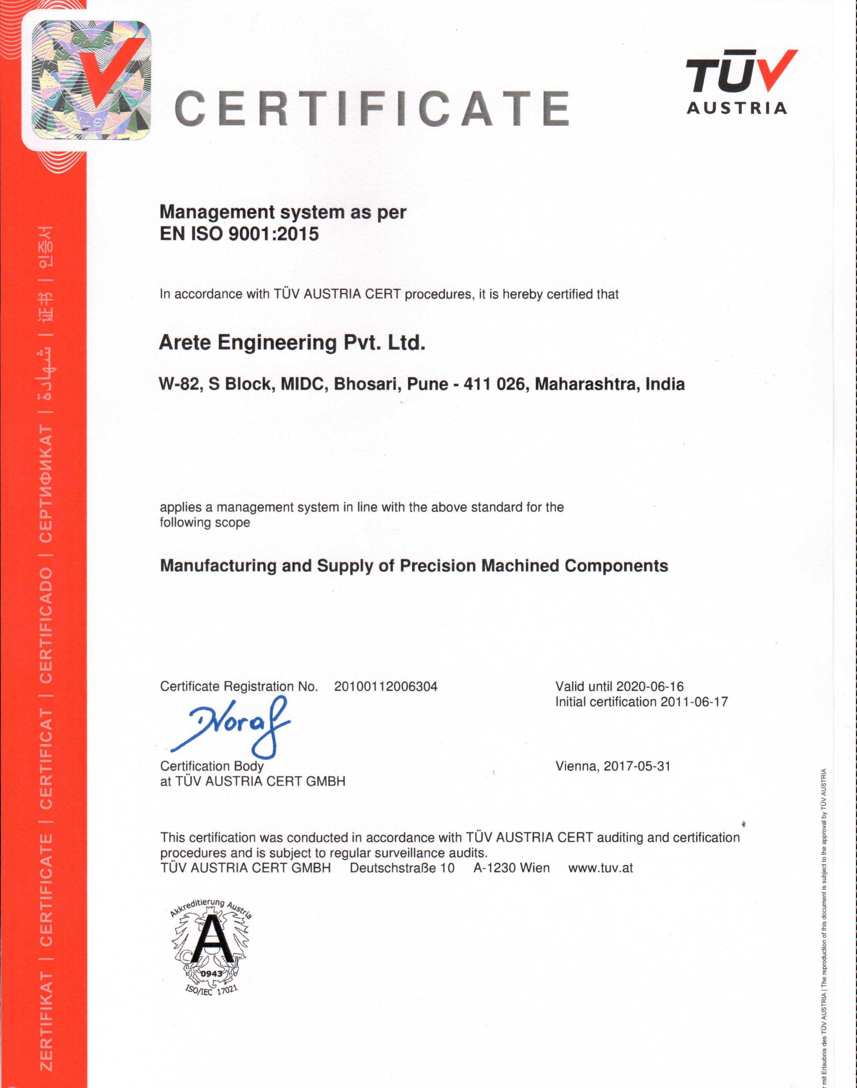
Quality -Systems

Slide 14
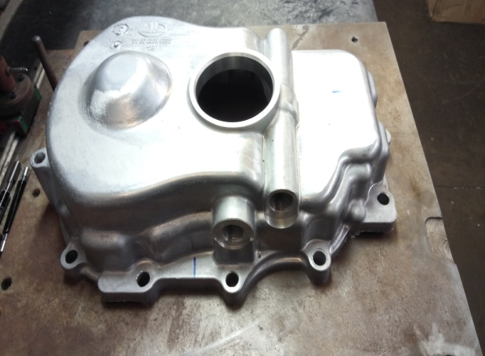
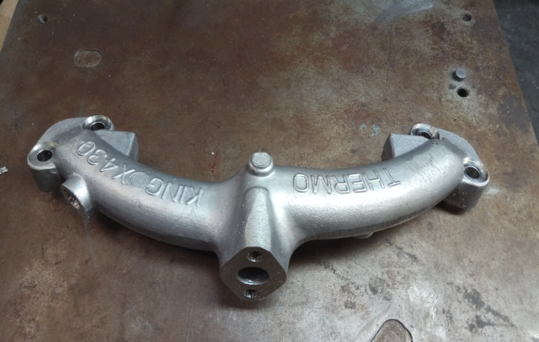
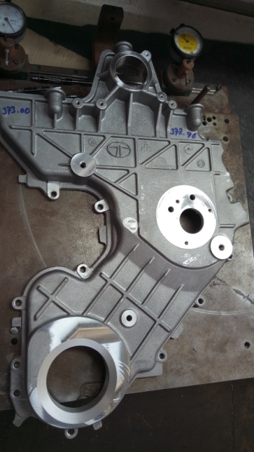
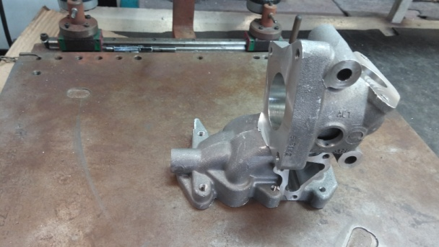
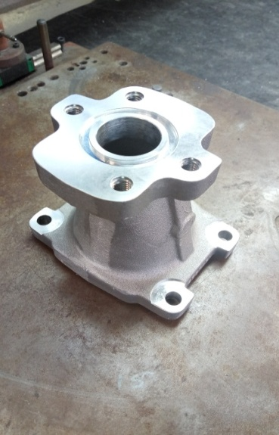
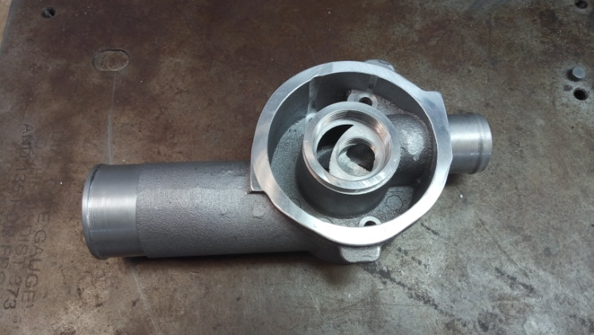
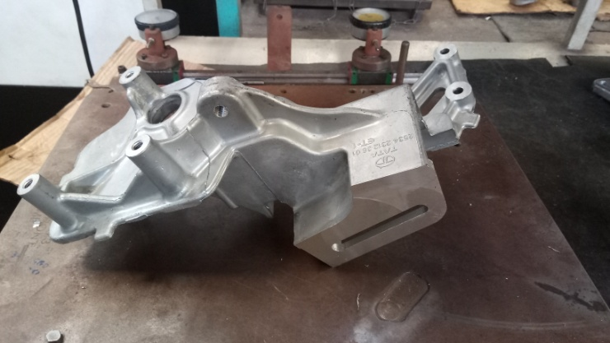
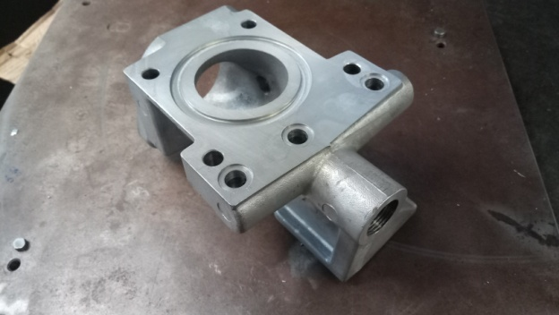
Few Of Our Products
Rear Cover
IR Manifold
EGR & BYPASS VALVE HSG-BODY
Front Cover
Suction Adapter
Head Filter
Sumo Gold
Outlet Housing

Slide 15
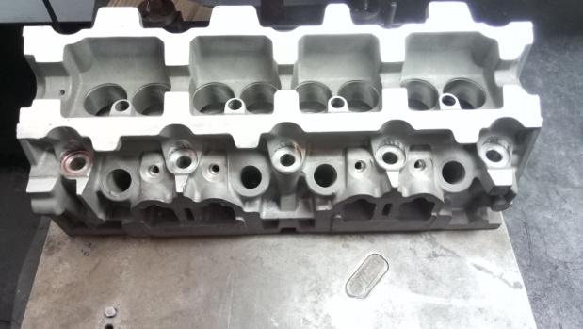
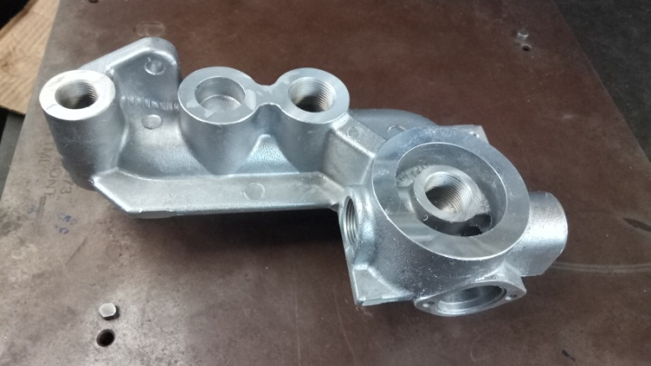
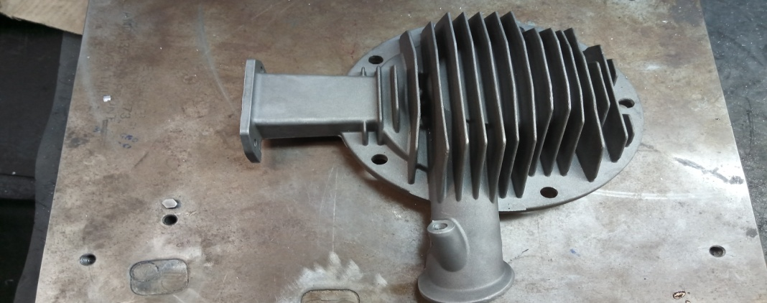
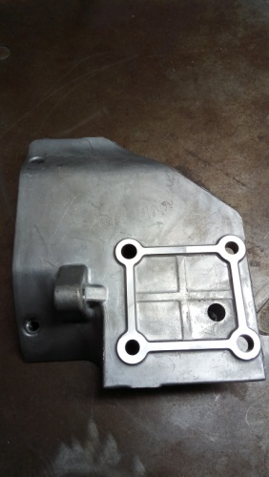
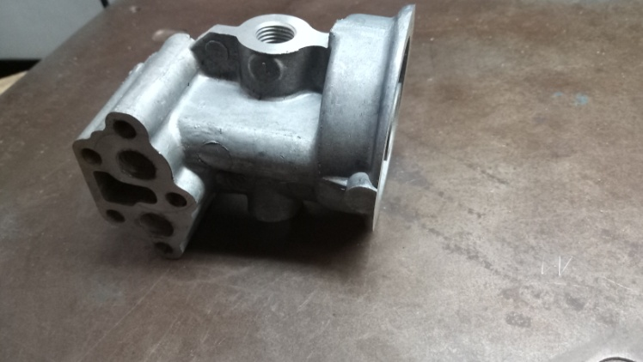
Few Of Our Products
XU-7
Oil Filter Housing
Valve Head
Subros Bracket
Oil Cooler Adapter

Slide 16
Customers
ALICON CASTALLOY LTD.
ENDURANCE TECHNOLOGIES LTD.
AMTEK AUTO LTD.
VIRGO ENGINEERS LTD.
HINDUSTAN PRESSINGS PVT. LTD.
YASH INDUSTRIES.
R V TECHNOPRODUCTS PVT LTD.

Slide 17
Thank you !

